Slide 1
gb (Green Building) EPC v1.0 Tutorial
Yun Joon Jung yjung77@gatech.edu
Mengyue Liao myliao@gatech.edu
Jan, 2018

Slide 2
Table of Contents
1. Introduction
1.1 What is gbXML?
1.2 What is gbEPC?
2. Set-up in Revit
2.1 Material
2.2 Space
2.3 Thermal zone
2.4 Cooling/Heating Set point
2.5 gbXML export
3. gbEPC
3.1 Python 2.7 installation
3.2 gbEPC implementation
3.3 Available parsing parameters
3.4 Bugs found in Revit
3.5 Version info

Slide 3
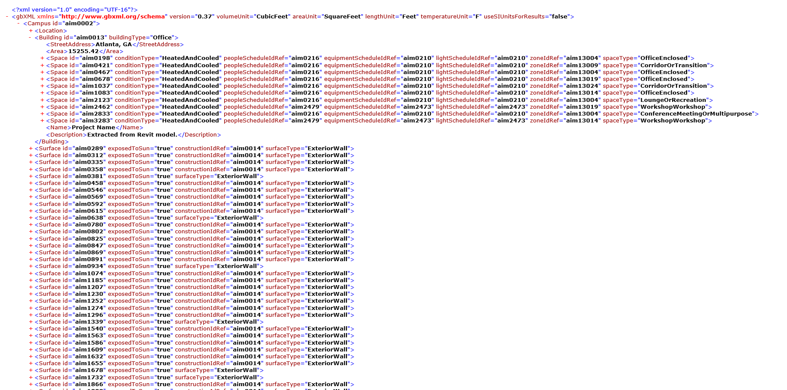
1.1 Intro - What is gbXML?
What is XML (eXtensible Markup Language)?
• XML is a markup language
→ Markup language is a language that annotates text so that the computer can manipulate that text.
• XML was designed to store and transport data
1
Example:
<University> Georgia Tech </University>
<Department> Architecture </Department>
2. What is gbXML (Green Building XML)?
• gbXML was developed to facilitate the transfer of building information stored in CAD-based building information models, enabling interoperability between disparate building design and engineering analysis software tools
2
Fig 1. gbXML instance file
Reference: [1] https://www.w3schools.com/xml/xml_whatis.asp [2]http://www.gbxml.org/About_GreenBuildingXML_gbXML

Slide 4


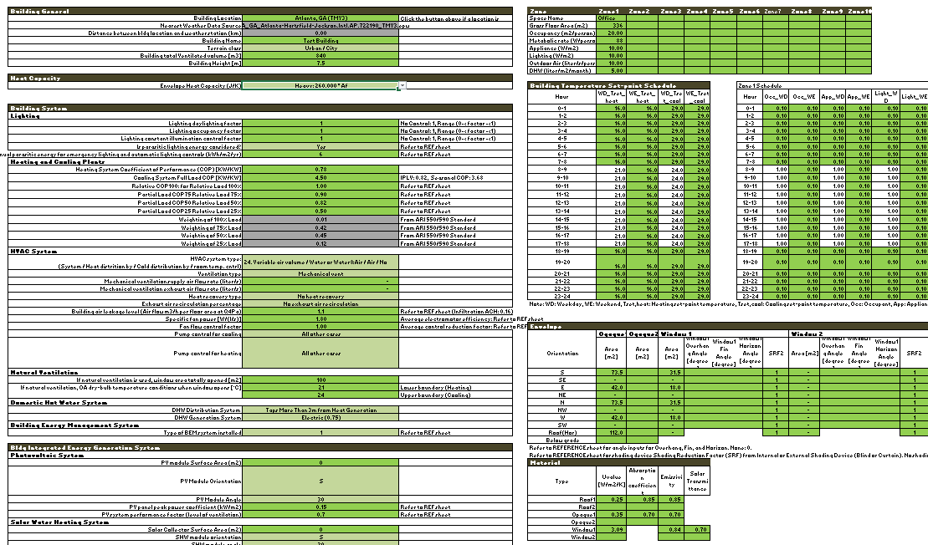

1.2 Intro - What is gbEPC?
gbEPC
EPC
Export
Fig 2. gbEPC schematic diagram
• gbEPC was developed to automate EPC simulation via gbXML
• gbEPC is a python code which can parse EPC input parameters from gbXML

Slide 5
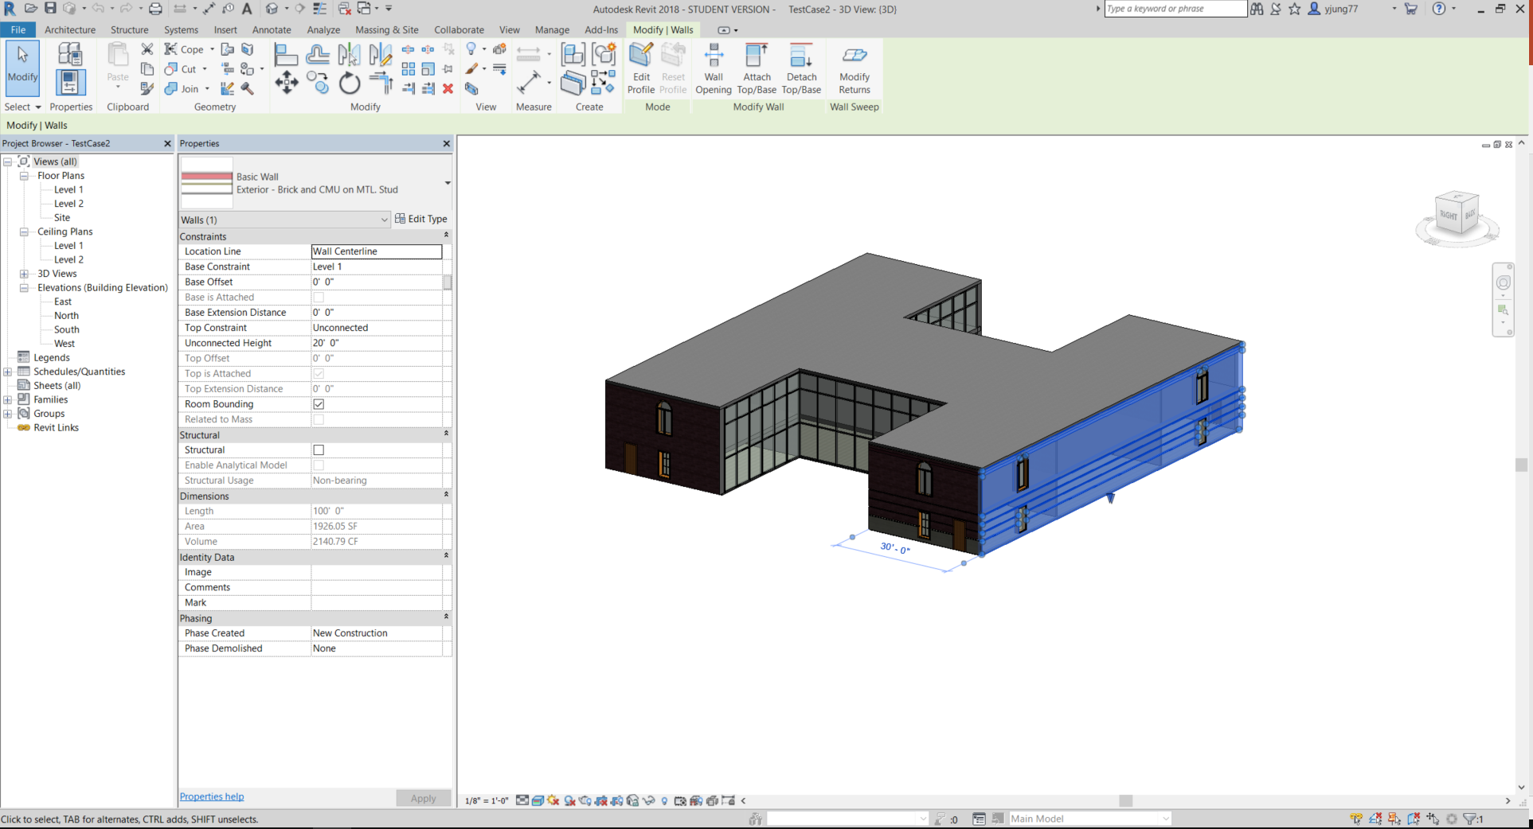
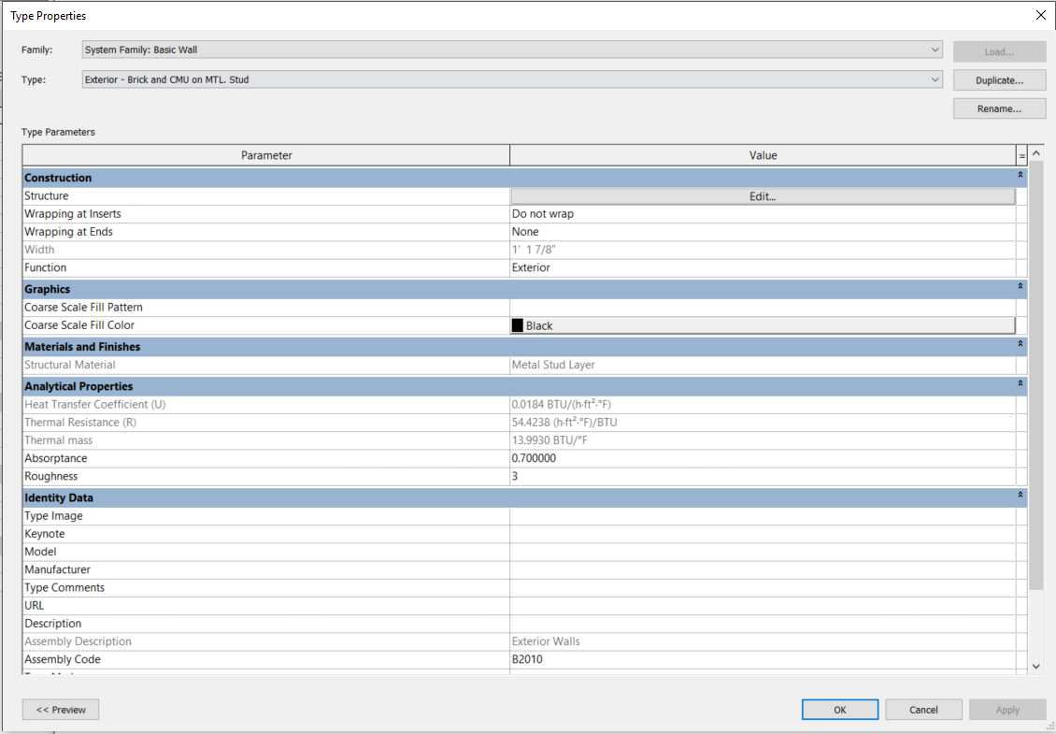
2.1 Revit – Material Thermal Properties
1. Hit Edit Type
2. Make sure thermal properties exist and are correct
Fig 3. Material set-up in Revit
• It doesn’t matter how many construction types exist because the gbXMLtoEPC was designed to use weighted average U-values (Utotal=(U1A1+U2A2+…)/Atotal) – same as absorption coefficient and Solar transmittance.

Slide 6
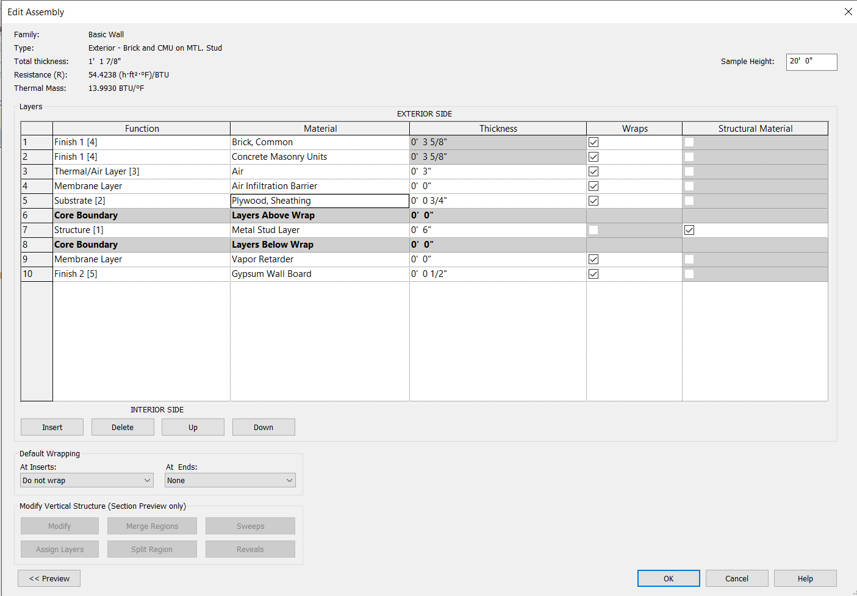
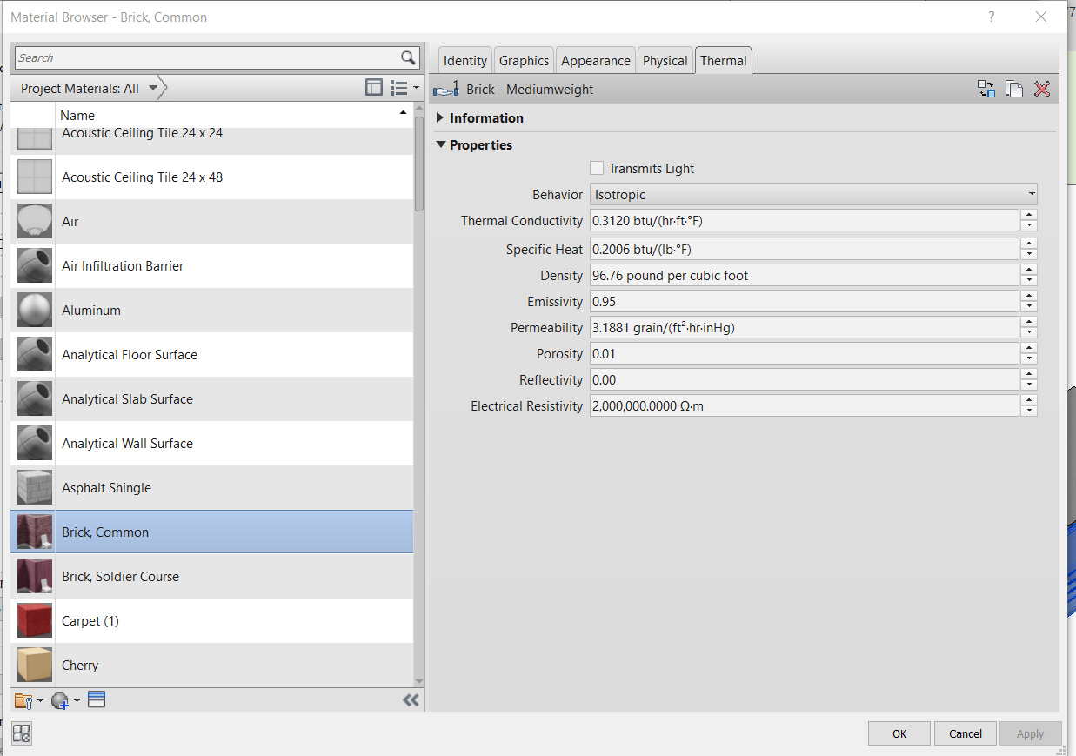
2.1 Revit – Material Thermal Properties
1. Hit Edit Type
3. Hit material
2. If you click material, you can customize the wall
4. Before customizing the wall, check the thermal information
Fig 4. Material customizing process
• If you want to customize the building wall, please follow the steps above.

Slide 7
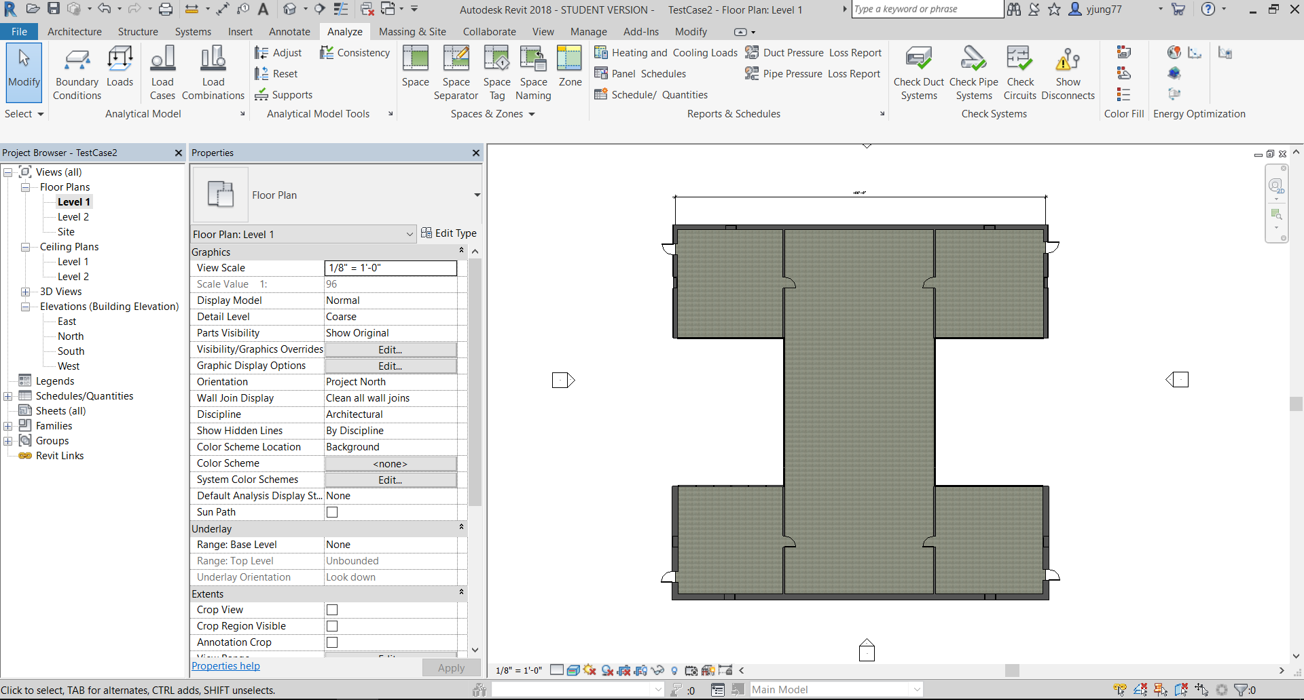
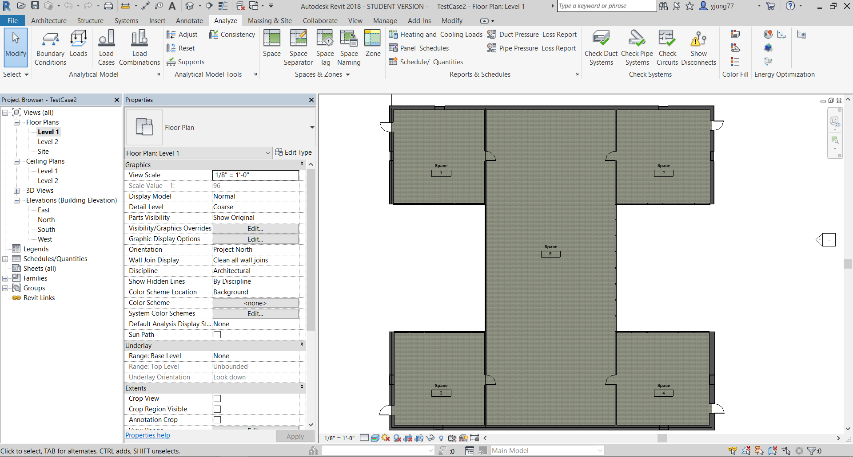
2.2 Revit – Space
1. Click Space and then set up individual space
2. Space tag is shown after setting up space
Fig 5. Space set-up in Revit
• If space tag is not shown, click Space Tag (blue box) → Annotations → Mechanical → Space Tag

Slide 8
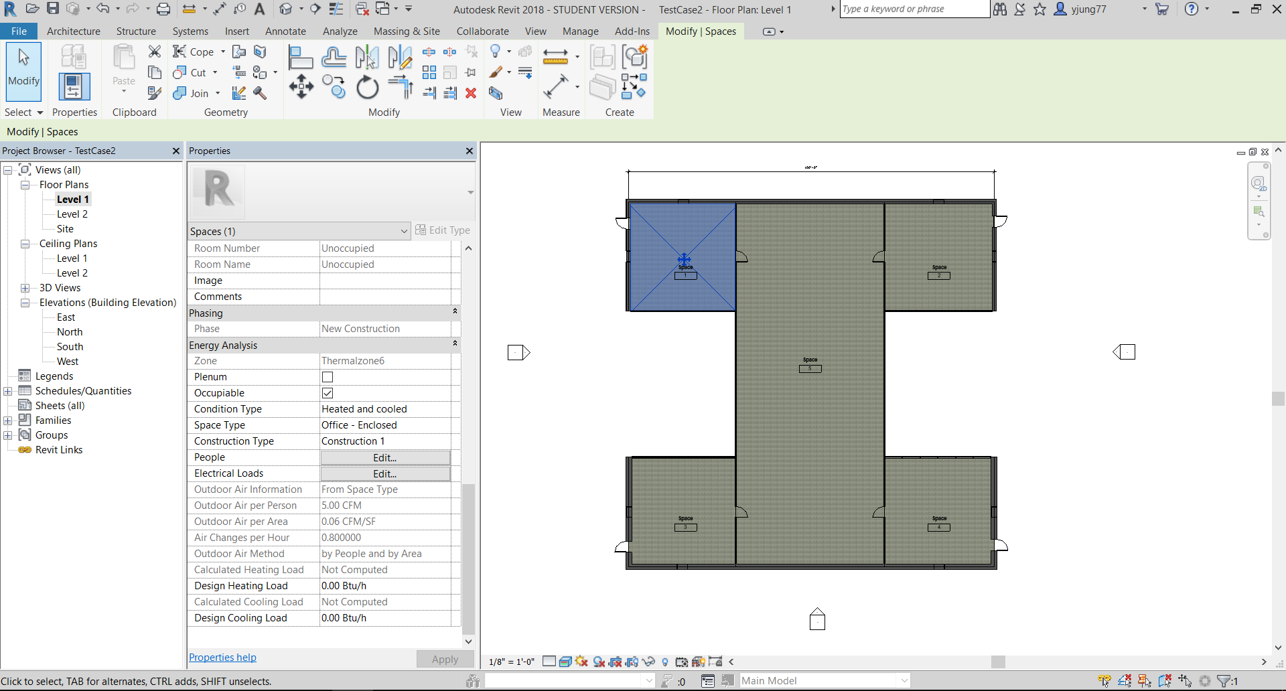
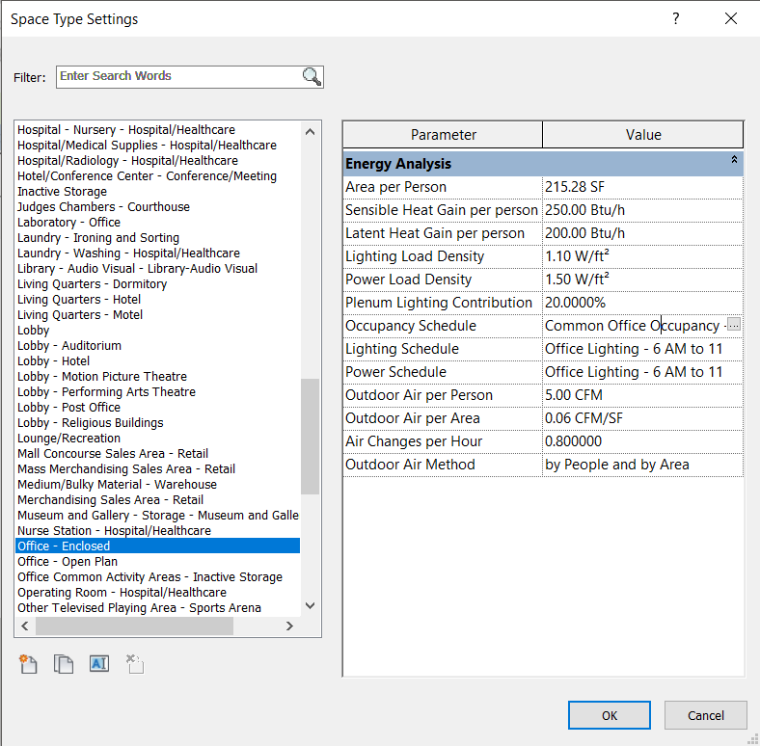
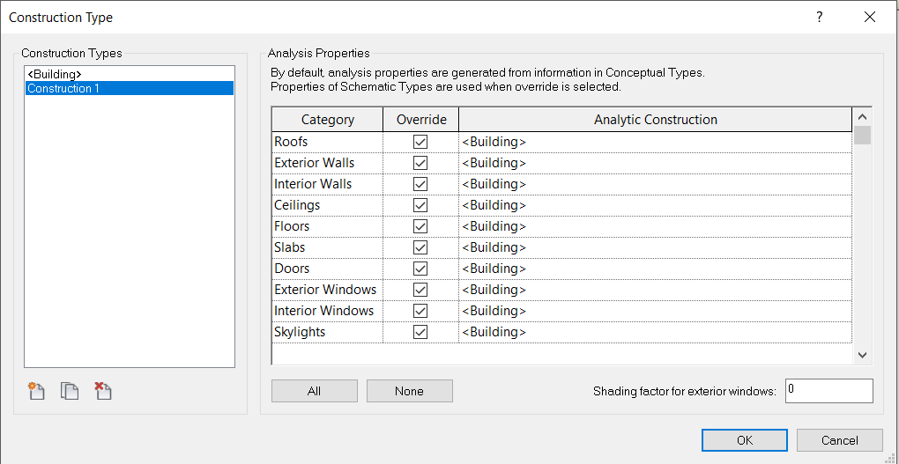
2.2 Revit – Space
1. Click each space
2. Select Heated or Cooled/Unconditioned
3. Select space type and Check if internal gains are correct. You can also create new space type by hitting green box left.
4. Click all of override and check analytic construction is “Building”
Fig 6. Space type set-up in Revit
• You should designate individual space one by one.

Slide 9
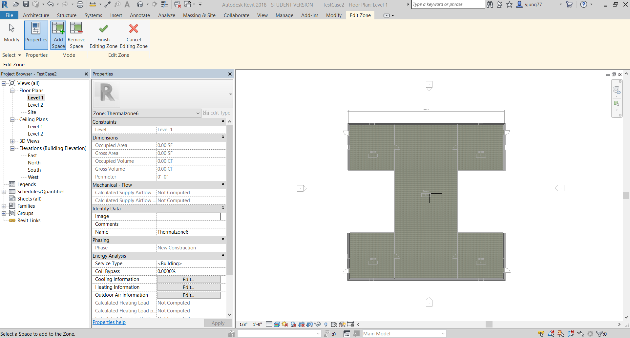
2.3 Revit – Thermal zone
2. If two spaces are same thermal zones, click the two spaces and then hit Finish Ending Zone
1. Click Zone to set up thermal zone
Fig 7. Thermal zone set-up in Revit
• More detail tutorial is available in the following link (https://www.youtube.com/watch?v=ftZkY6pmNGQ&index=5&list=LLptFwQQSnDAcmIZXPY1EwaA)

Slide 10
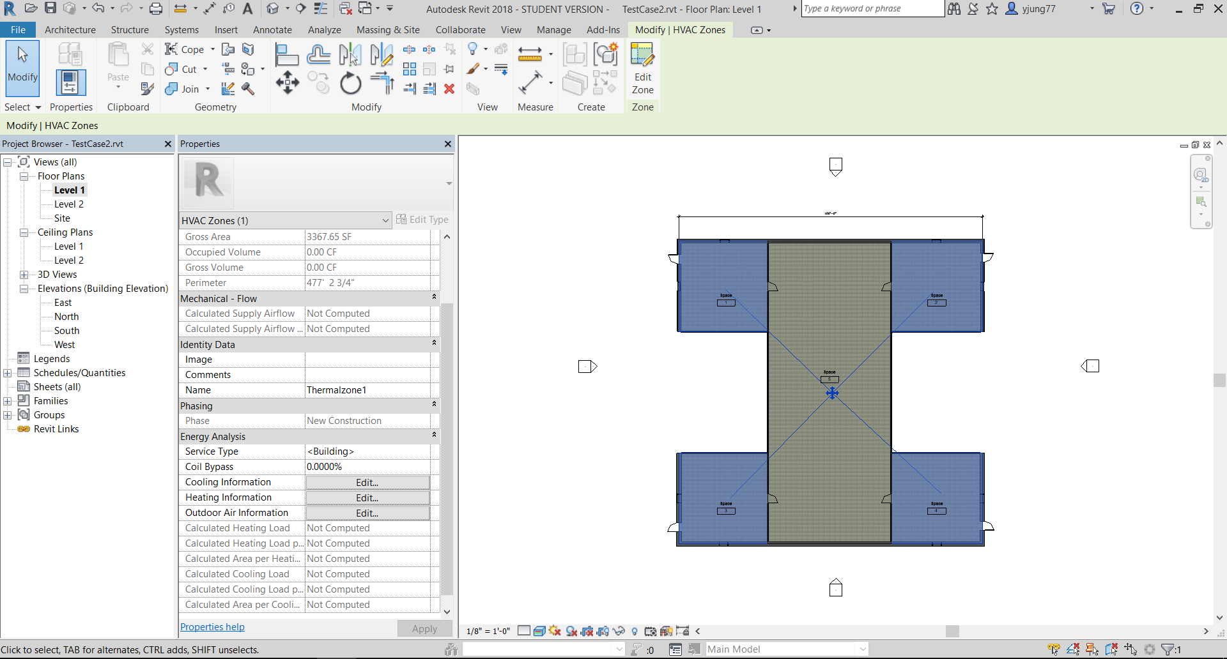
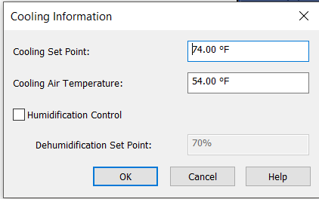
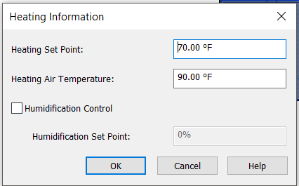
2.4 Revit – Cooling/Heating set point
3. Set up cooling set point
1. Click thermal zone
4. Set up heating set point
2. Click cooling/heating information
Fig 8. Cooling/Heating set point set-up in Revit

Slide 11
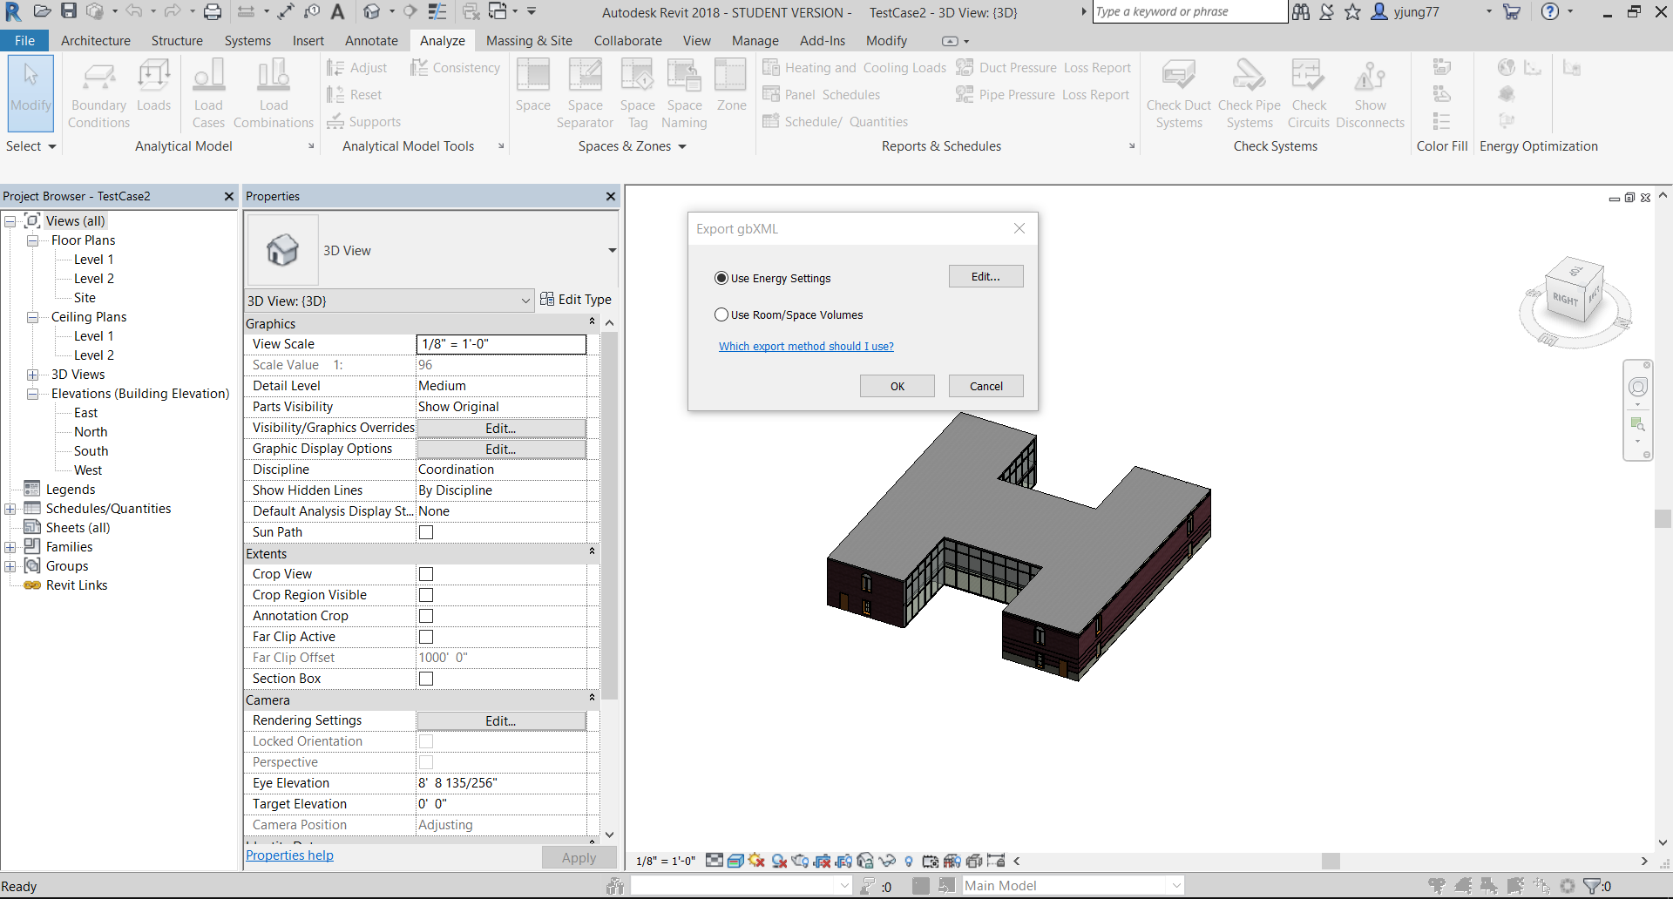
2.5 Revit – Export gbXML
To have Export gbXML window, click File -> Export -> gbXML
Click Edit
Fig 9. gbXML export in Revit
• You must follow 2.4 (Export gbXML) section because if UseRoom/Space Volume is used, Roof’s construction type info are not exported.

Slide 12
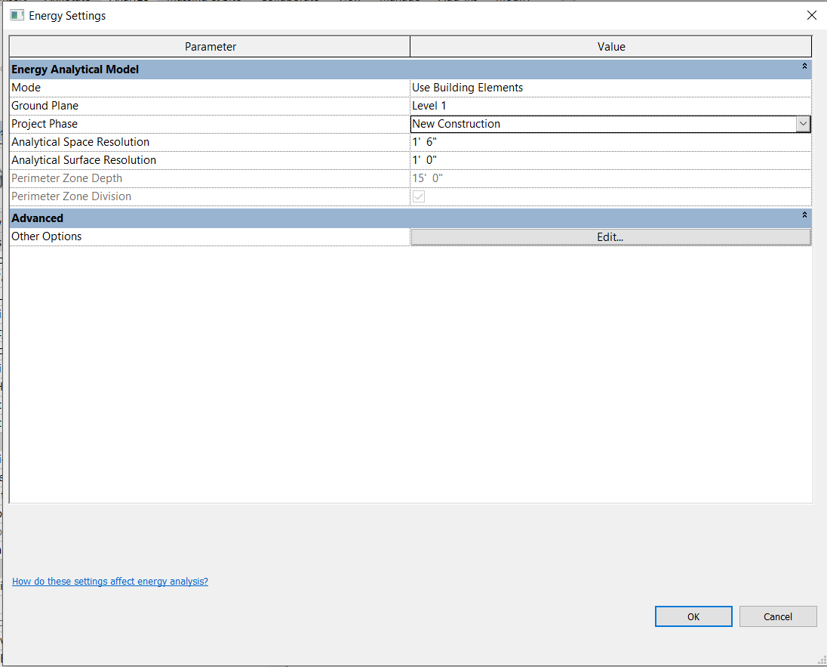
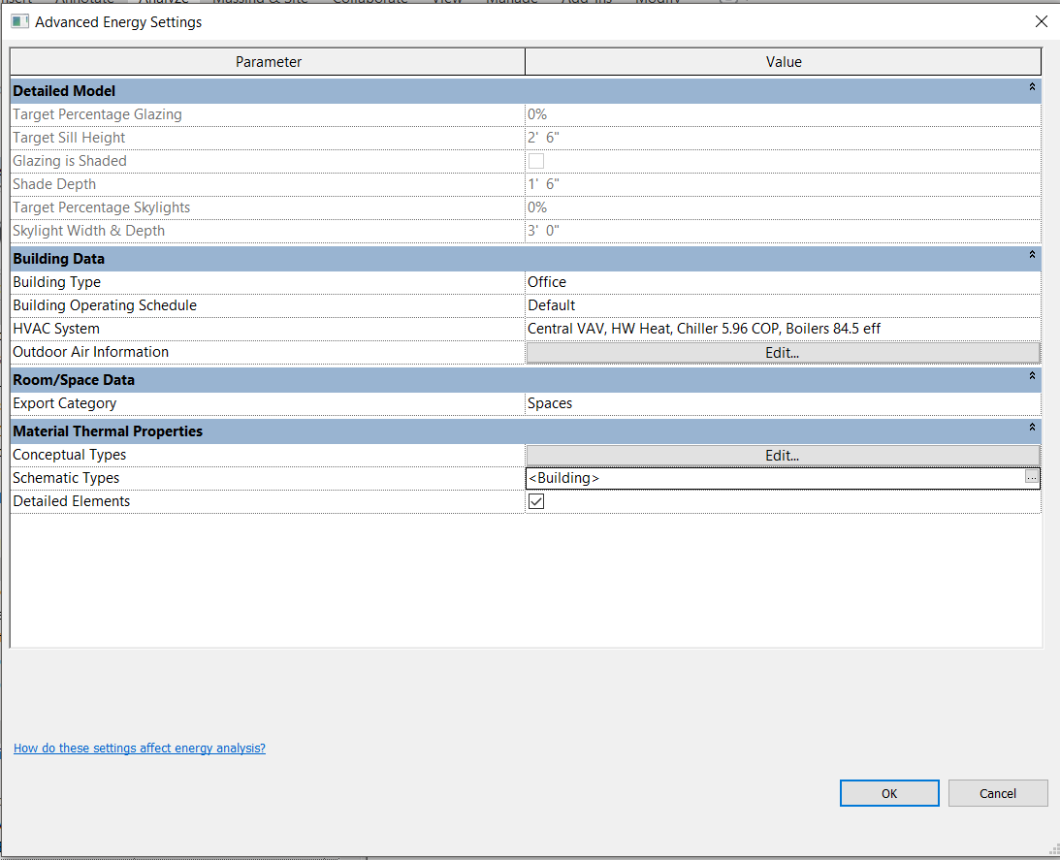
2.5 Revit – Export gbXML
Must select Use Building Elements
Must select New Construction
Click Edit
Must select Spaces
Fig 10. gbXML export in Revit
Must be checked
• After finishing this step, click OK and then gbXML file is exported

Slide 13
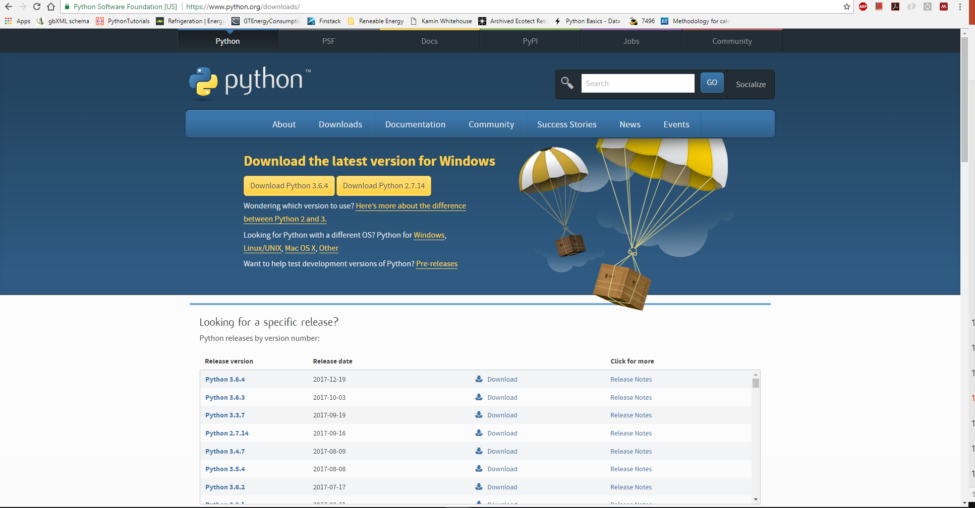
3.1 gbEPC - Python installation
1. Download Python 2.7 version
Fig 11. Python homepage
• First, it is required to install Python 2.7. You can download Python 2.7 for free in the link (https://www.python.org/).
• Detail python install tutorial is available in the link (https://www.youtube.com/watch?v=QYUBz4mrnFU).

Slide 14
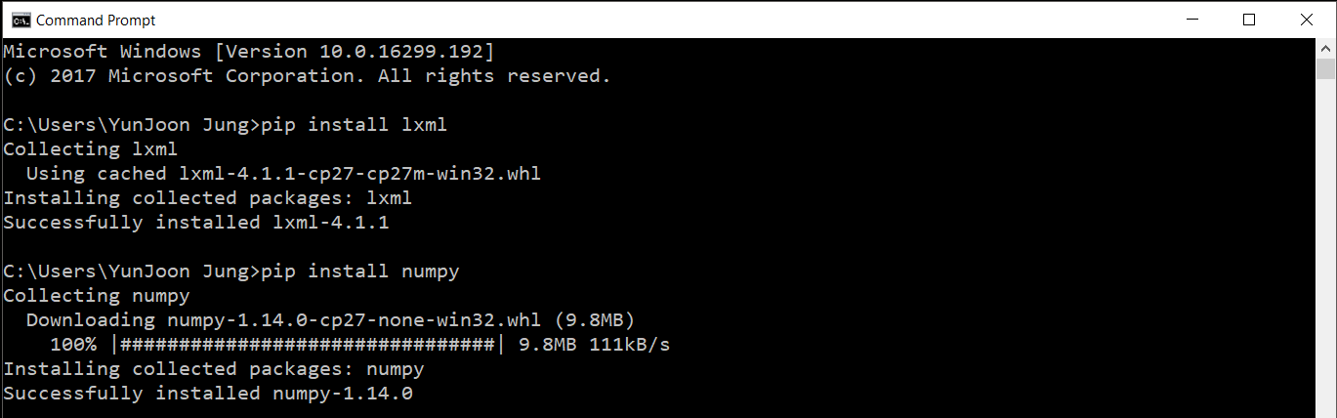
3.1 gbEPC - Python installation
Fig 12. Command prompt window
• Open command prompt window (Start → type command prompt)
• Install lxml, numpy and openpyxl modules using pip install
→ file directory (green box) doesn’t matter when pip install is used
→ type “pip install lxml”, “pip install numpy” and “pip install openpyxl”
→ After succeeded, “Successfully installed (module name)” message is shown

Slide 15
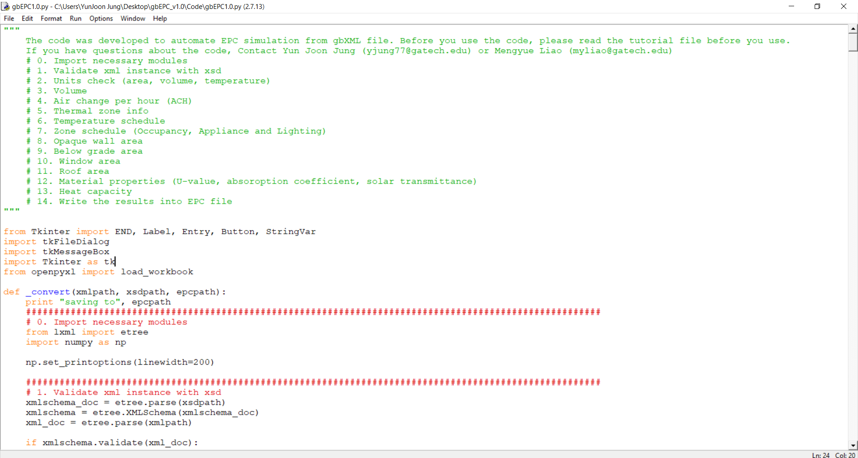
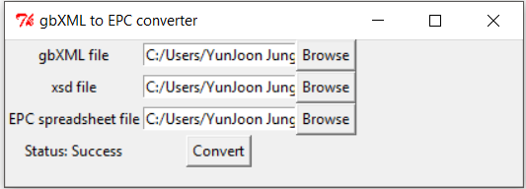
3.2 gbEPC – gbEPC implementation
1. Open gbEPC python code and run the code
2. gbXML file: Browse your gbXML file exported from Revit
3. Xsd file: xsd extension means gbXML schema file. Browse “GreenBuildingXML_Ver6.01.sxd” file. The file is in the code folder
4. EPC spreadsheet file: Browse “EPC_Input.xlsx” file. The parsing results are saved in EPC_ Input file. However, The file is not actual EPC file. Thus, users have to copy the results to the actual EPC file.
Fig 14. gbEPC implementation

Slide 16
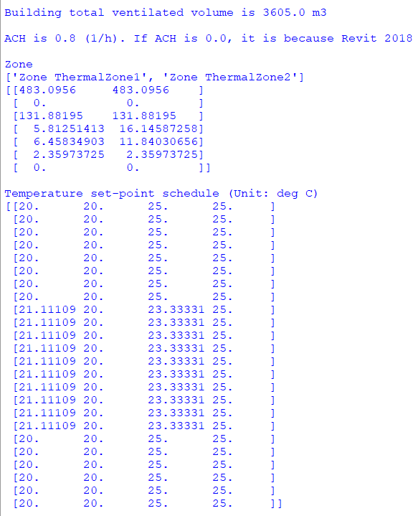
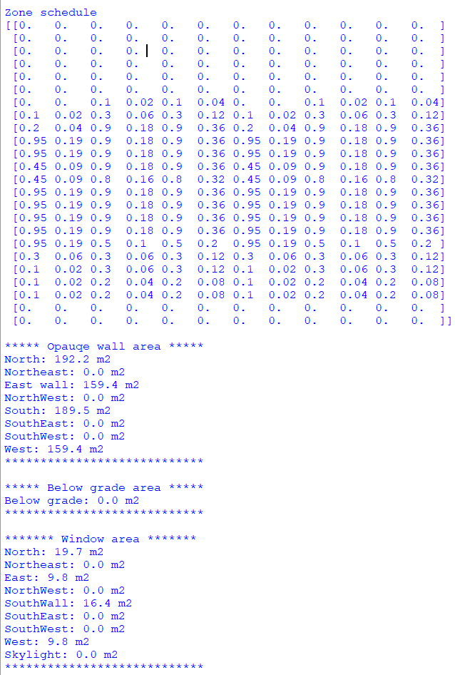
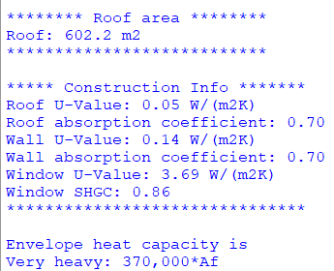
3.3 gbEPC – Available parsing parameters
• Total ventilated volume, ACH, Zone, Temp schedule, Opaque/window/roof/below grade, Construction info and heat capacity can be parsed
Fig 13. gbEPC Testcase1 result

Slide 17
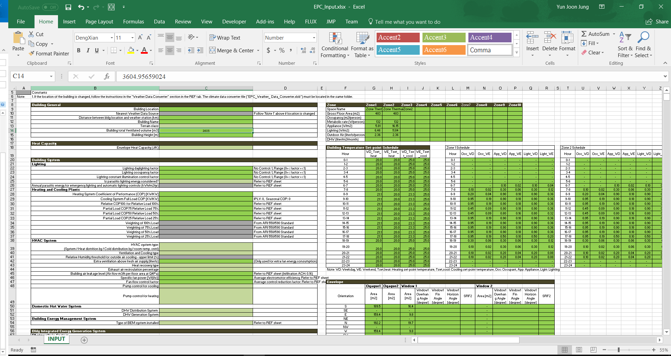
3.3 gbEPC – gbEPC implementation
Fig 15. gbEPC implementation result
• gbEPC results are automatically saved into EPC_Input.xlsx file.

Slide 18
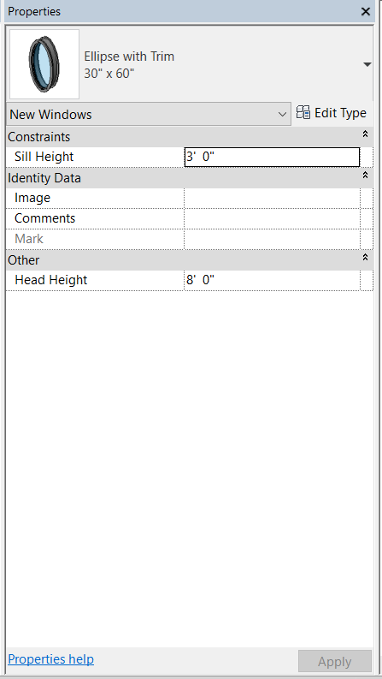
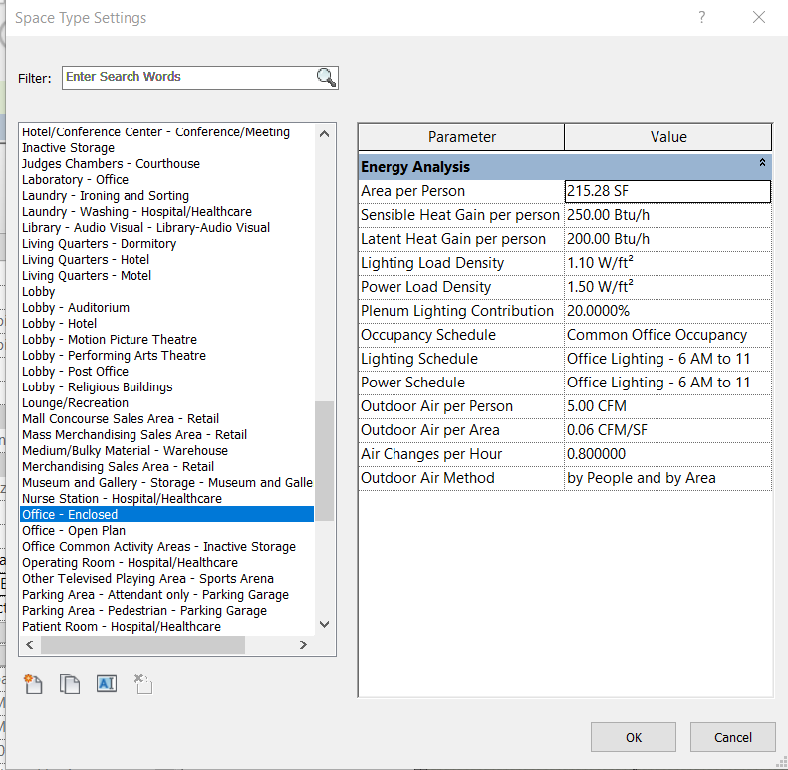
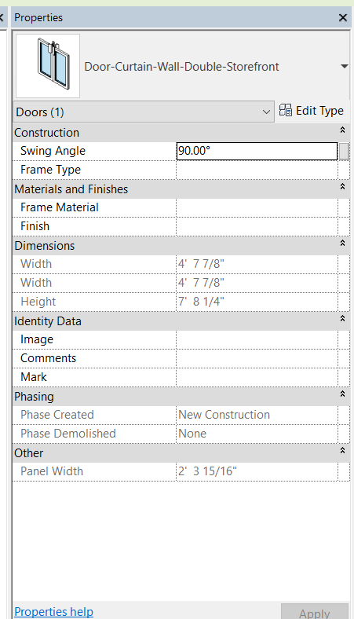
3.4 gbEPC – Bugs found in Revit
• In Revit 2018, there were a few bugs found
1. Ellipse with Trim window
2. Area per person
3. Curtain wall door
This window doesn’t create gbXML correctly. Thus, it creates an error in gbEPC code
Area per person information is not exported into gbXML
Curtain wall is OK to use but curtain wall door is not exported into gbXML

